Slide 1
Vision Transformer
ECN-300 Lab Based Project
( Prof. Tharun Kumar Reddy )
Name: Yawalkar Ajinkya Ganpati
Enrollment Number: 21116108
Email: y_aganpati@ece.iitr.ac.in

Slide 2
Outline
Introduction
Background
Abstract
Dataset
Transformer Architecture
Encoder
Self Attention
Multi head Attention
Patch Embedding
Positional Embedding
Optimizer and Loss function
Results
References

Slide 3
Background
The project aims to predict driver drowsiness based on reaction time predicted using EEG data , which is measured frequencies received from different brain locations due to various brain activities from a computer-based program.
We used visual signals to reorganize or retrain the brain signals, which were feedback from brain activities.
By responding to the simulation, clients learn to regulate and improve their brain function and to alleviate symptoms of various neurological and mental health disorders.

Slide 4
Abstract
In this project, we center our attention on Vision Transformer (ViT), an evolution of the Transformer architecture tailored for visual tasks.
Originally developed by Google for language translation, the ViT model employs self-attention mechanisms to process sequences effectively.
Unlike traditional recurrent neural networks (RNNs) and convolutional models, ViT demonstrates superior performance in tasks like language translation.
Leveraging ViT's transformative capabilities, we aim to adapt its implementation for encoding EEG signals, thereby enhancing driver drowsiness detection.
By modifying the input and output layers of ViT and leveraging self-attention, we can effectively capture temporal dependencies within EEG sequences, paving the way for robust driver monitoring systems.

Slide 5
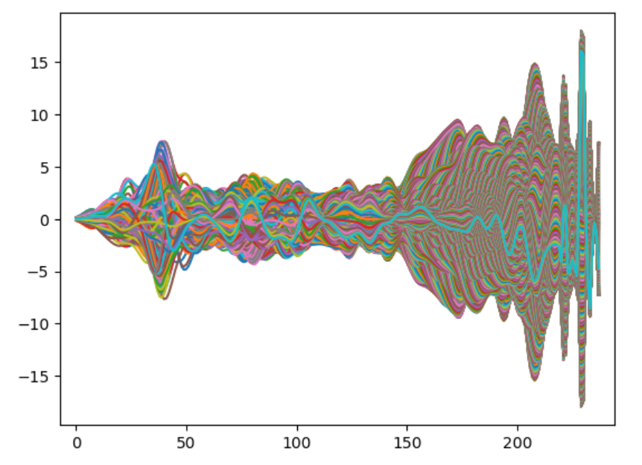

EEG Dataset
Our EEG dataset :
the input data and output data as [30,1250,1609] and [1,1609] respectively.
The three parameters stand for number of channels, time stamps, epochs.
Below is the visualization of data.
Wxt has shape of (30,238,1250)
So, 30 channels, 30 different plots.
0th channel data plotted

Slide 6
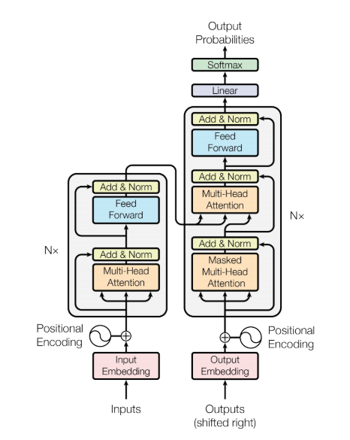
Architecture
Transformer Architecture

Slide 7
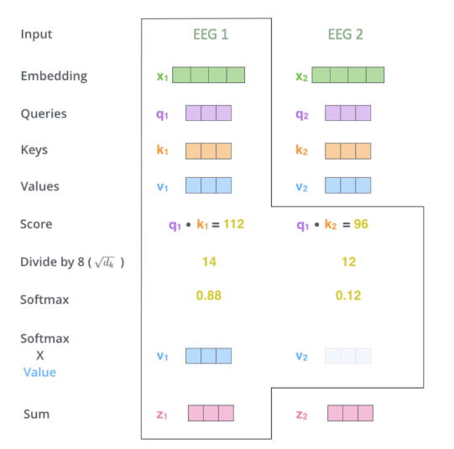
Self Attention
A mechanism that computes the importance of each word/token in the input sequence with respect to every other word/token.
Allows the model to weigh the relevance of different words when encoding the input.
Each word/token attends to all other words/tokens, and the attention weights are used to compute a weighted sum of the values.
Self Attention Block
Notes:
Self-Attention Mechanism: The core component of the ViT architecture is the self-attention mechanism. Self-attention allows the model to weigh the importance of different input features when making predictions. It computes a weighted sum of all input features, where the weights are determined dynamically based on the similarity between features.

Slide 8
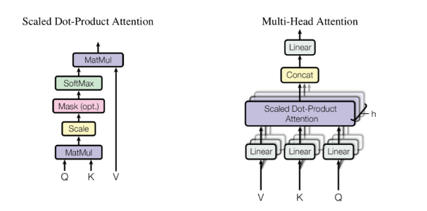
Multi Head Attention
It helps the model to focus on EEGs on different positions. It is true that in the self-embedding layer, it contains a little bit of the other EEGs. However, it is still dominated by the actual EEG itself.
With the help of multi-headed attention, we can access multiple sets of Q/K/V weight matrices, which are all initialized randomly
After training, each matrix can project the output of lower layer into different representation subspace.
Notes:
Multi-Head Attention: To enhance the representational capacity of self-attention, ViT uses multi-head attention. Multi-head attention involves performing self-attention multiple times in parallel, each with different learned linear projections. This allows the model to attend to different parts of the input image simultaneously, capturing diverse patterns and relationships.

Slide 9
Encoder & Decoder Block
The encoder block processes the input image by dividing it into patches, linearly projecting each patch into embedding vectors, and adding positional encodings.
It consists of a multi-head self-attention mechanism followed by a feed-forward neural network (FFNN) for each patch.
The self-attention mechanism allows the model to capture global dependencies within the image, while the FFNNs enable nonlinear transformations.
Finally, layer normalization and residual connections are applied to stabilize and facilitate information flow through the network.
Unlike traditional transformers used in natural language processing, ViTs do not have a decoder block.
ViTs operate in an autoregressive manner, where each token in the output sequence is generated independently based on the previously generated tokens and the encoded image embeddings.
Therefore, the decoder functionality in ViTs is implicit in the autoregressive generation process.
Notes:
Transformer Encoder: The ViT architecture consists of multiple transformer encoder blocks stacked on top of each other. Each encoder block typically includes a multi-head self-attention layer followed by a feed-forward neural network (FFN) layer. The self-attention layer captures global dependencies within the input image, while the FFN layer applies non-linear transformations to the features.
Classification Head: Finally, ViT includes a classification head that takes the output of the transformer encoder and produces predictions for the input image. This typically involves applying a global average pooling operation to aggregate features across spatial locations, followed by a linear layer to map the aggregated features to class probabilities.

Slide 10
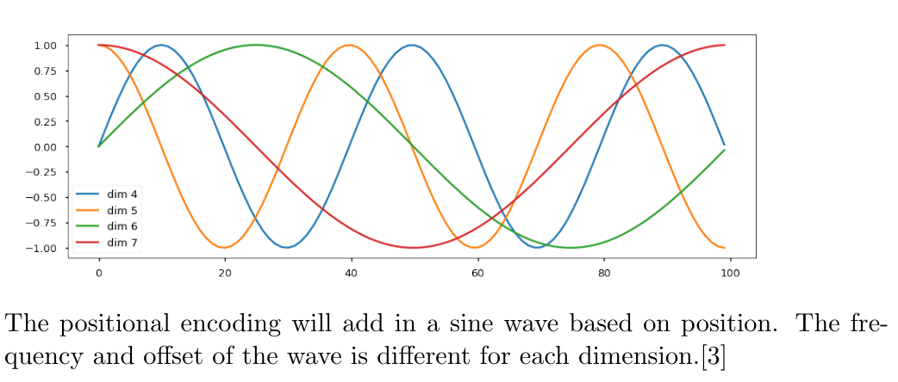
Positional & Patch Embeddings
ViTs process input images by dividing them into fixed-size patches, each of which is treated as a token. These patches serve as the fundamental units of input for the transformer encoder.
The patch embeddings are generated by applying a learnable linear projection to each patch of the input image. This projection maps the pixel values of each patch into a high-dimensional embedding space, allowing the model to capture features and patterns within each patch.
By representing image patches as embeddings, ViTs enable the transformer architecture to process visual data in a tokenized manner, like how tokens are processed in natural language processing tasks.
Since the model contains no recurrence and no convolution, for the model to make use of the order of the sequence, we must inject some information about the relative or absolute position of the tokens in the sequence.
Notes:
Patch Embedding: In ViT, the input image is divided into fixed-size patches, and each patch is treated as a token. These patches are linearly embedded into a lower-dimensional space using a trainable linear projection. This process converts each patch into a vector representation that can be processed by the transformer layers.
Positional Embedding: Since transformers do not inherently understand the order of tokens, positional information needs to be provided explicitly. Positional embeddings are added to the patch embeddings to encode spatial information about the input image. These embeddings allow the model to learn spatial relationships between different patches.

Slide 11
Optimizer & Loss Function
* The Adam optimizer is employed for optimization, with a learning rate of 0.001.
* Loss Function:
Mean Squared Error (MSE) is employed as the loss function, which computes the average squared difference between the predicted values and the ground truth labels.

Slide 12
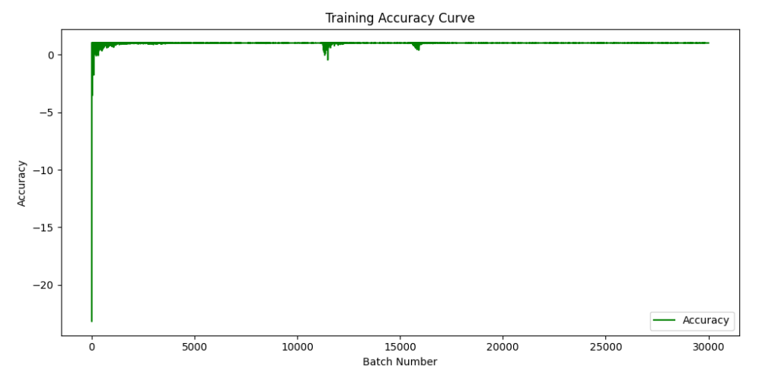
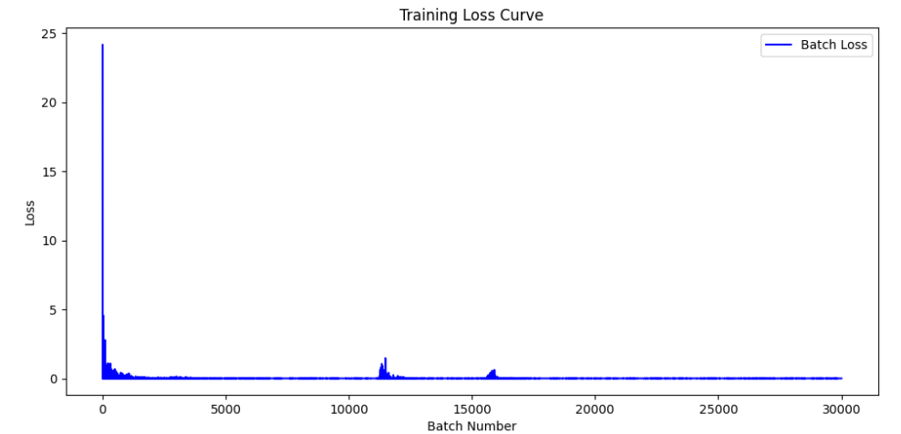
Results
1. Training Dataset Accuracy and Loss Curve
Train Accuracy = 1 – Loss = 99.03 %

Slide 13
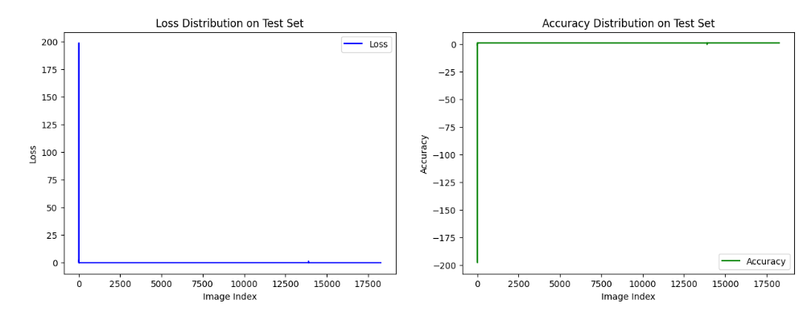
Results
2. Test Dataset Results :
Loss = 0.0127
Accuracy = 1 – Loss = 98.73%

Slide 14
References
[1] Ashish Vaswani, Noam Shazeer, Niki Parmar, Jakob Uszkoreit, Llion Jones, Aidan N Gomez, L ukasz Kaiser, and Illia Polosukhin. Attention is all you need. pages 5998– 6008, 2017.
EEG Classification Research Github
EEG Conv2D Github

Slide 15
Thank You

